Slide 1
Mental Health: A scriptural and clinical perspective
Sinmi Onuche, M.S., M.HR, LPC

Slide 2
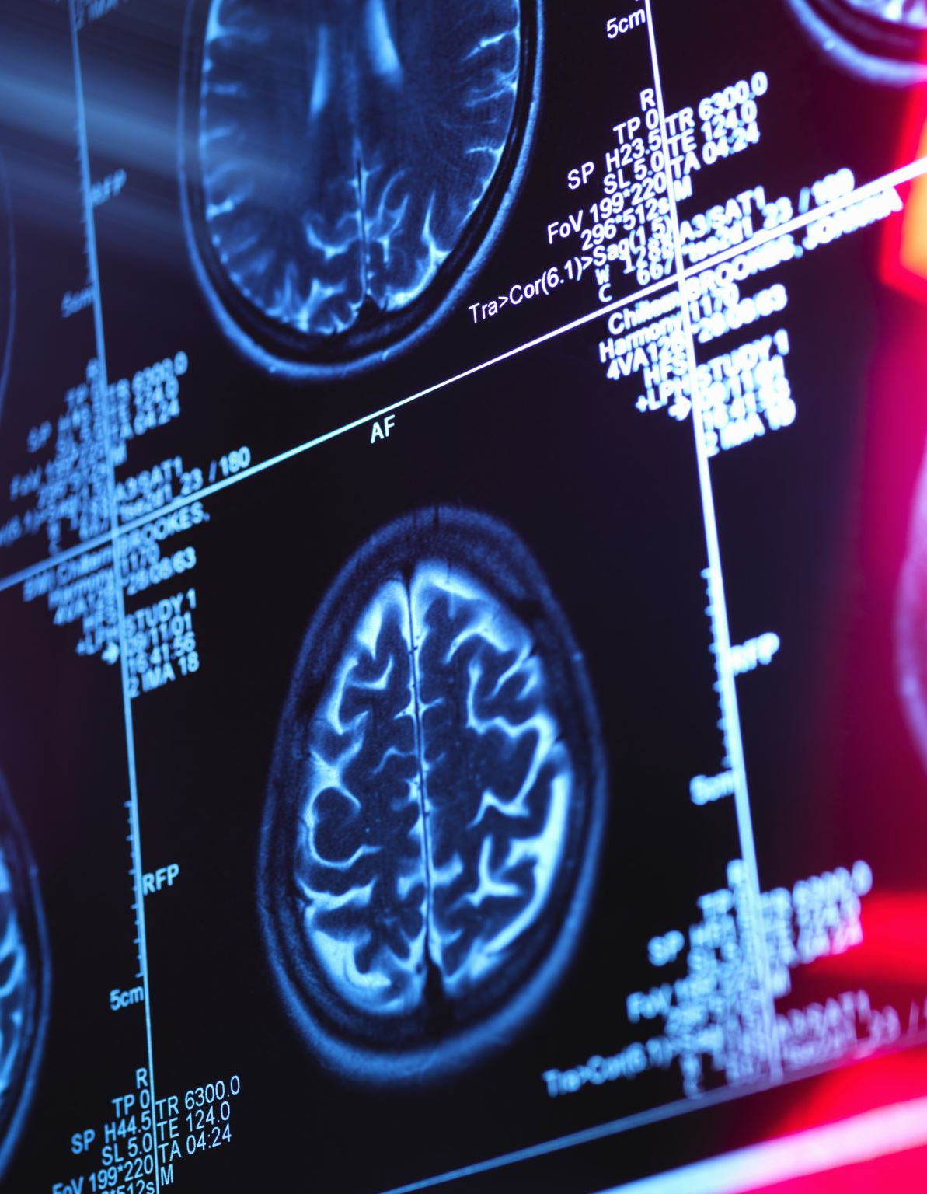
Agenda
Scripture
What is mental health?
where does it affect us?
Who does it affect?
Why does it affect us?
When does if affect us?
How can we treatment mental health symptoms?

Slide 3
Matthew 22:37-39
“Jesus said unto him, though shalt love the Lord thy God with all they heart, and with all thy soul, and with all thy mind. This is the first and great commandment. And the second is like unto it, though shalt love thy neighbor as thyself. “
(King James Version, 1769/2023)

Slide 4
What is mental health?
American Psychiatric Association, 2023, notes:
Mental illnesses are health conditions involving changes in emotion, thinking or behavior (or a combination of these).
Mental illnesses can be associated with distress and/or problems functioning in social, work or family activities.
Nearly one in five (19%) U.S. adults experience some form of mental illness.
One in 24 (4.1%) has a serious mental illness*.
(major depressive disorder, schizophrenia and bipolar disorder)
One in 12 (8.5%) has a diagnosable substance use disorder.
Mental illness is treatable. The vast majority of individuals with mental illness continue to function in their daily lives.

Slide 5
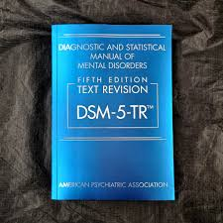
APA, 2023

Slide 6
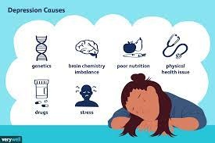
Major depressive Disorder (mood disorder)
The individual must be experiencing five or more symptoms during the same 2-week period and at least one of the symptoms should be either (1) depressed mood or (2) loss of interest or pleasure.
Depressed mood most of the day, nearly every day.
Markedly diminished interest or pleasure in all, or almost all, activities most of the day, nearly every day.
Significant weight loss when not dieting or weight gain, or decrease or increase in appetite nearly every day.
A slowing down of thought and a reduction of physical movement (observable by others, not merely subjective feelings of restlessness or being slowed down).
Fatigue or loss of energy nearly every day.
Feelings of worthlessness or excessive or inappropriate guilt nearly every day.
Diminished ability to think or concentrate, or indecisiveness, nearly every day.
Recurrent thoughts of death, recurrent suicidal ideation without a specific plan, or a suicide attempt or a specific plan for committing suicide.
Verywell/Joshua Seong
Truschel,2022

Slide 7
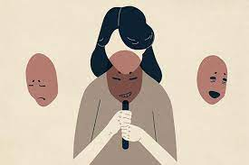
Bipolar I disorder
Characterized by:
mania, the elevated, expansive, or irritable mood must last for at least one week and be present most of the day, nearly every day.
To be considered hypomania, the mood must last at least four consecutive days and be present most of the day, almost every day. (Bipolar 2 disorder)
During this period, three or more of the following symptoms must be present and represent a significant change from usual behavior:
Evolve psychiatry
Inflated self-esteem or grandiosity
Decreased need for sleep
Increased talkativeness
Racing thoughts
Distracted easily
Increase in goal-directed activity or psychomotor agitation
Engaging in activities that hold the potential for painful consequences
e.g., unrestrained buying sprees
Truschel, 2020

Slide 8
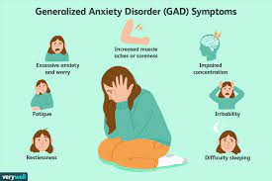
General Anxiety Disorder (anxiety disorder)
The anxiety and worry are associated with three or more of the following six symptoms with at least some symptoms present for more days than not for the past 6 months:
restlessness or feeling keyed up or on edge
easily fatigued
difficulty concentrating or mind going blank
irritability
muscle tension
sleep disturbance such as difficulty falling or staying asleep, or restless and unsatisfying sleep.
Verywell/ Cindy Chung
Arnold,2022
Notes:
Discuss: Panic disorder/ phobia (agoraphobia)

Slide 9
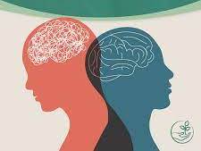
Borderline Personality Disorder (personality disorder)
A pervasive pattern of instability in interpersonal relationships, self-image and affects, and marked impulsivity beginning by early adulthood and present in a variety of contexts, as indicated by five or more of the following:⁵
fear of abandonment
unstable or changing relationships
unstable self-image, including struggles with sense of self and identity
stress-related paranoia
anger regulation problems, including frequent loss of temper or physical fights
consistent and constant feelings of sadness or worthlessness
self-injury, suicidal ideation, or suicidal behavior
frequent mood swings
impulsive behaviors such as unsafe sex, reckless driving, binge eating, substance abuse, or excessive spending
Thira health
Millard, 2022

Slide 10
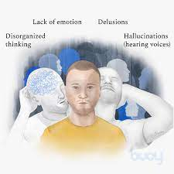
Schizophrenia Disorder (psychotic disorder)
1. Two or more of the following for at least 1 month (or longer period of time), and at least one of them must be a 1, 2, or 3:
delusions
hallucinations
disorganized speech
grossly disorganized or catatonic behavior
negative symptoms, such as diminished emotional expression
1. Impairment in one of the major areas of functioning for a significant period of time since the onset of the disturbance: Work, interpersonal relations, or self-care.
2.Schizoaffective disorder and bipolar or depressive disorder with psychotic features have been ruled out:
No major depressive or manic episodes occurred concurrently with active phase symptoms
Some signs of the disorder must last for a continuous period of at least 6 months. This six-month period must include at least one month of symptoms (or less if treated) that meet criterion A (active phase symptoms) and may include periods of residual symptoms. During residual periods, only negative symptoms may be present.
Buoy/Chung
Hurley, 2022

Slide 11
ADHD (neurodevelopmental disorder)
Potential Inattention Symptoms
Often fails to give close attention to details or makes careless mistakes in schoolwork, at work, or during other activities
Often has difficulty sustaining attention in tasks or play activities
Often does not seem to listen when spoken to directly
Often does not follow through on instructions and fails to finish schoolwork, chores, or duties in the workplace
Often has difficulty organizing tasks and activities
Often avoids, dislikes, or is reluctant to engage in tasks that require sustained mental effort
Often loses things necessary for tasks or activities
Is often easily distracted by extraneous stimuli
Is often forgetful in daily activities
Potential Hyperactivity Symptoms
Often fails to give close attention to details or makes careless mistakes in schoolwork, at work, or during other activities
Often has difficulty sustaining attention in tasks or play activities
Often does not seem to listen when spoken to directly
Often does not follow through on instructions and fails to finish schoolwork, chores, or duties in the workplace
Often loses things necessary for tasks or activities
Is often easily distracted by extraneous stimuli
Potential Impulsivity Symptoms
Often blurts out an answer before a question has been completed
Often has trouble waiting his/her turn
Often interrupts or intrudes on others
Harrar, 2022

Slide 12
Important: What is mental health?
Needs to be clinically distressing
Needs to cause clinically significant impact on functioning in more than one setting (i.e., school, work, social)
Impairment cannot be attributed to substances
Impairment cannot be better explained by another mental health disorder or medical condition

Slide 13
Where does mental health affect us?

Slide 15
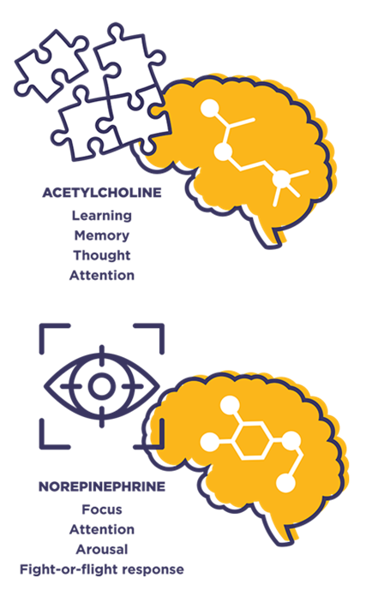
Where does MH affect us?
It affects our mind.
Psychological
Personality/Character
Emotion regulation
Attention/concentration
Processing speed (slow comprehension)
Sleep (hypersomnia vs. insomnia)
Appetite (increased weight gain/ decreased weight)
Energy level (chronic fatigue vs. grandiose goal-directed energy)
Stress
HPRC, 2023

Slide 16
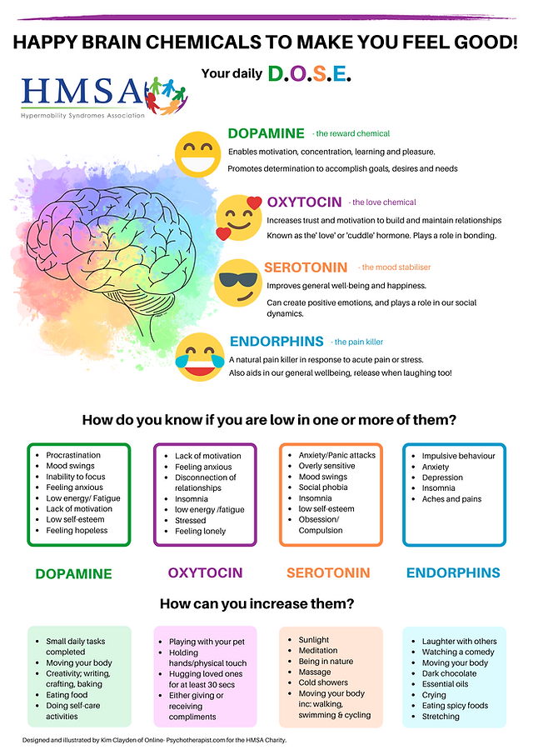
Where does MH affect us?
It affects our brain and whole body.
Neurologically/Medical
Memory (forgetfulness, misplacing things, getting lost/confused))
Attention/concentration (focus, attentiveness, losing train of thought)
Decision making/problem solving
Impulsivity/poor inhibition
Slowed thinking/racing thoughts/ intrusive thoughts
Personality (social vs. withdrawn, hot-tempered vs. calm/quiet)
Cognitive complaints (recurrent migraines/headaches, head pressure)
Increase in chemical messengers in the body
Hypermobility, 2022

Slide 17
Who does MH affect?
Anyone
Notes:
King Saul- distressing spirit in 1 Samuel 18:10-11, the Lord sent a spirit onto Saul—an “evil spirit” in the New International Version, or a “distressing spirit” in the New King James Version. OR Elijah- depression

Slide 18
Why does it affect us?

Slide 19
Notes:
Also SPIRITUAL- as in the case of King Saul (I Sam 18:10-11)

Slide 20
When does MH affect us?
During emotions (stress)
After horrible events (trauma, depression)
Before important events (anxiety)

Slide 21
How can we treat MH symptoms?
Gold standard clinically is with psychotherapy and psychopharm medications
Meds said to do 10% of work
Balances body neural chemistry
Psychotherapy-90%
Gets to the root cause of anxiety, depression, trauma, etc
Notes:
There are multiple types of psychotherapy. Some types of therapy are considered evidences based interventions (i.e. Cognitive-Based Therapy)

Slide 22
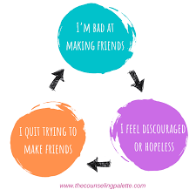
(Tranquility, 2023)
(Counselingpalette, 2021)

Slide 23
Acceptance and Commitment Therapy
Goldminz, 2018
Notes:
ACT therapy works by focusing on accepting life experiences as they come, without evaluating or trying to change them. It's a skill developed through mindfulness exercises that encourage you to build a new and more compassionate relationship with difficult experiences.

Slide 24
Examples of negative thinking patterns
Cognitive Processing Therapy
Cognitive Processing Therapy (CPT) is one specific type of Cognitive Behavioral Therapy. It is a 12-session manualized intervention for PTSD.
CPT teaches you how to evaluate and change the upsetting thoughts you have had since your trauma. By changing your thoughts, you can change how you feel.

Slide 25
MH Treatment
Clinical interview
Current problem
History of current problem
Medical history
Psychological history
Psychosocial history
Developmental history
Educational history
Occupational history
Substance-use history
Neuropsychological tests and Psychological tests
Intelligence tests
Mental Health Screeners (quick assessment of symptoms)
Personality tests
Attention test
Memory tests
Diagnostic impressions
Recommendations
THE MOST IMPORTANT PART
Visual motor tests
Visual spatial tests
Academic/achievement tests
Premorbid and Global function tests
Language tests
Clinical advice on how to strength weaknesses and/or better manage deficits
Psychotherapy (i.e., learn new coping skills, develop positive habits, improve communication methods, process hurtful events and foster developmental healing)
Medication (gives you body the physiological balance it may need)
Notes:
In the clinical interview, the clinician is asking questions pertaining to all categories. This better helps their integrated conceptualization of the current complaints and mental health diagnosis.
Neuropsychological or Psychological testing provides objective results compared to personal demographics to better assess strengths and deficits in specific areas.

Slide 26
Who is my Neighbor? Matthew 5:44-45
44“But I say unto you, Love your enemies, bless them that curse you, do good to them that hate you, and pray for them which despitefully use you, and persecute you;
45 That ye may be the children of your Father which is in heaven: for he maketh his sun to rise on the evil and on the good, and sendeth rain on the just and on the unjust..”
Read: Matthew 25:31-46
Notes:
As Matt 22: 37-39 instructs us to also love our neighbor as our self. This verse of Matt 5:44-45 also depicts are neighbors might be those we despise, look down on, and even avoid. For us to better love those called our neighbors, understanding them and their weaknesses, even the mental health weakness, will help us better know them, understand them, and show them love.

Slide 27
Hebrews 12:2

Slide 28
References
Arnold, Elizabeth. (2023). Anxiet DSM-5 Diagnostic Criteria and Treatment Overview. https://pro.psycom.net/assessment-diagnosis-adherence/anxiety
American Psychiatric Association (APA), 2023. What is mental illness. https://www.psychiatry.org/patients-families/what-is-mental-illness
American Psychiatric Association, Diagnostic and Statistical Manual of Mental Disorders, Fifth Edition, American Psychiatric Publishing, Washington, DC, 2013: Pages 99-105.
American Psychiatric Association, Diagnostic and Statistical Manual of Mental Disorders, Fifth Edition Text-Revised. American Psychiatric Publishing, Washington, DC, 2013.
Counseling Palette (2021). https://www.thecounselingpalette.com/post/the-famous-cbt-triangle-with-examples-and-worksheets
Chung, Cindy. (2023). Generalized Anxiety Disorder (GAD) Symptoms photograph. Verywell mind. https://www.verywellmind.com/dsm-5-criteria-for-generalized-anxiety-disorder-1393147
Chung, Cindy. (2023). Schizophrenia photograph. Buoy health. https://www.buoyhealth.com/learn/schizophrenia
Evole Psychiatry. (2023). Bipolar Disorder Massapequa, NY. Photograph. https://www.evolvepsychiatry.com/blog/what-you-should-know-about-bipolar-disorder/
Goldminz, Itamar, (2018). Intro to Acceptance and Commitment Therapy. https://orghacking.com/intro-to-acceptance-and-commitment-therapy-c735309f8610
Harrar, Sari. (2022). ADHD Diagnosis: where to go and what to know. https://www.psycom.net/adhd/worst-mother-ever
Hurley, Katie. (2022). Schizophrenia:DSM-5 Definition. https://pro.psycom.net/assessment-diagnosis-adherence/schizophrenia
Human Performance Resources by Champ (HPRC). (2023). Acetylcholine and norepinephrine photograph. https://www.hprc-online.org/total-force-fitness/tff-strategies/warfighter-brain-health-part-3-neurotransmitters
Hypermobility (2022). HAPPY BRAIN CHEMICALS TO MAKE YOU FEEL GOOD! https://www.hypermobility.org/post/
King James Bible. (2023). King James Bible Online. https://www.kingjamesbibleonline.org/ (Original work published 1769)
Millard, Elizabeth. (2022). Borderline Personality Disorder: DSM-5 Criteria, Comorbidities, and Treatments. https://pro.psycom.net/assessment-diagnosis-adherence/borderline-personality-disorder-dsm-5-criteria-comorbidities-and-treatments
Perspectives Clinic (2023). Health Psychology. http://perspectivesclinic.com/health-psychology
Ryan, Shirley. (2023). Brain Lobe by Function photograph.Ability Lab. https://www.sralab.org/articles/blog/understanding-parts-brain
Seong, Joshua. (2023). Depression causes photograph. Verywell mind. https://www.verywellmind.com/common-causes-of-depression-1066772
Thira Health. (2022). Healing from Borderline Personality Disorder photograph. https://www.thirahealth.com/2022/09/13/the-painful-parts-of-healing-from-bpd/
Tranquility (2023). https://www.tranquility.app/home-product-3-1
Truschel, Jessica. (2022). Depression Definition and D5M-5 Diagnostic Criteria. https://www.psycom.net/depression/major-depressive-disorder/dsm-5-depression-criteria
Truschel, Jessica. (2020). Bipolar Definition and DSM-5 Diagnostic Criteria. https://www.psycom.net/bipolar-definition-dsm-5

