Slide 1
What makes success
&
The Struggle

Slide 2
Roger Godwin
Founder of OUTSiDE the BOX
Child of HIS, Husband, Daddy, Mayor of Warr Acres, Connector, International Encouragement Speaker
Domestic and International Entrepreneur and Real Estate Investor.
District 8 Board Member for Mayors Council of Okla.

Slide 3
I messed up for years trying to build an “EMPIRE”

Slide 4
1 Timothy 5:8
But if anyone does not provide for his relatives, and especially for members of his household, he has denied the faith and is worse than an unbeliever.

Slide 5
What does that make you feel?

Slide 6
What really Matters

Slide 7
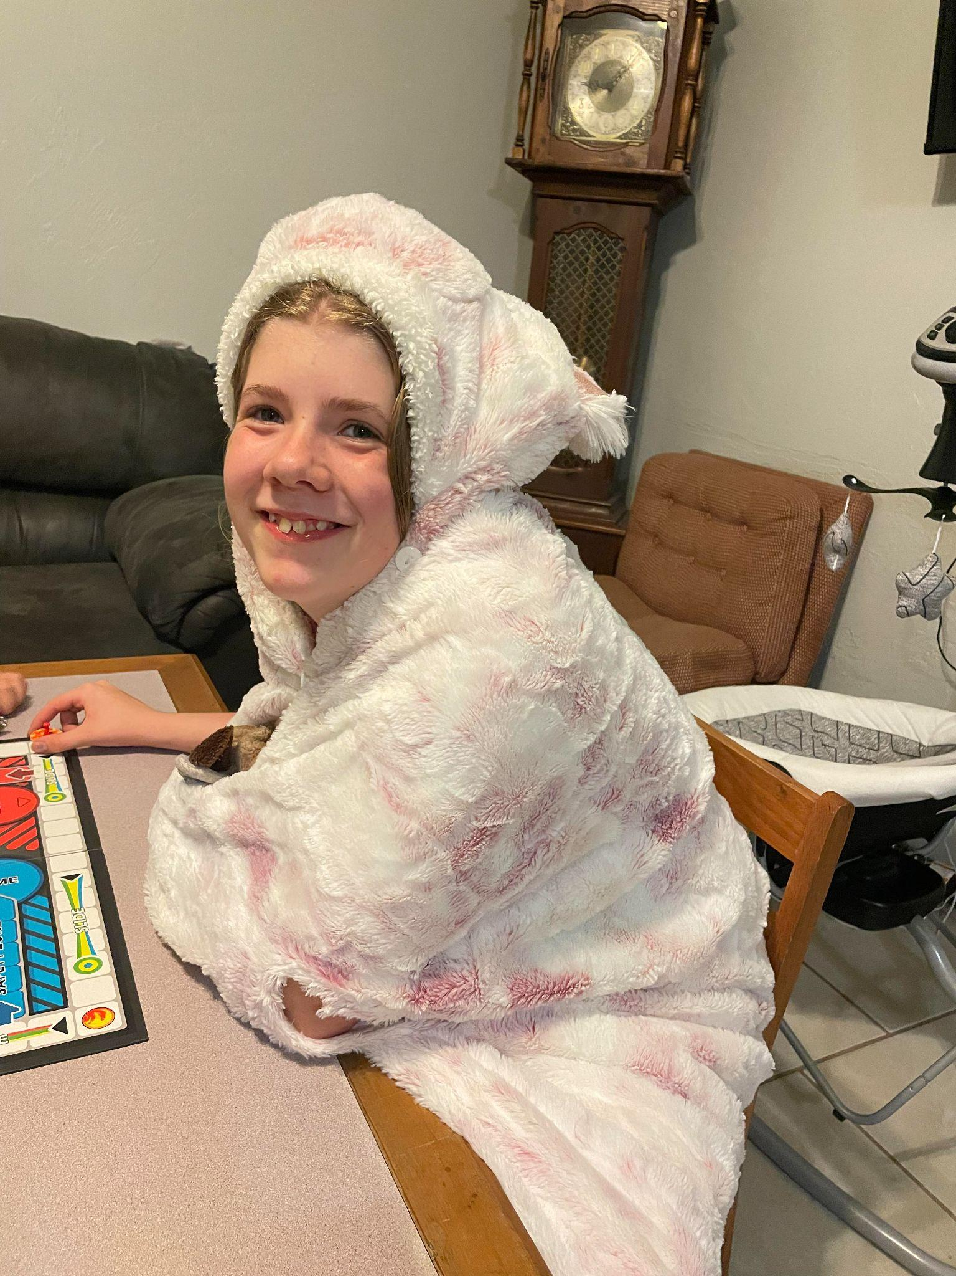
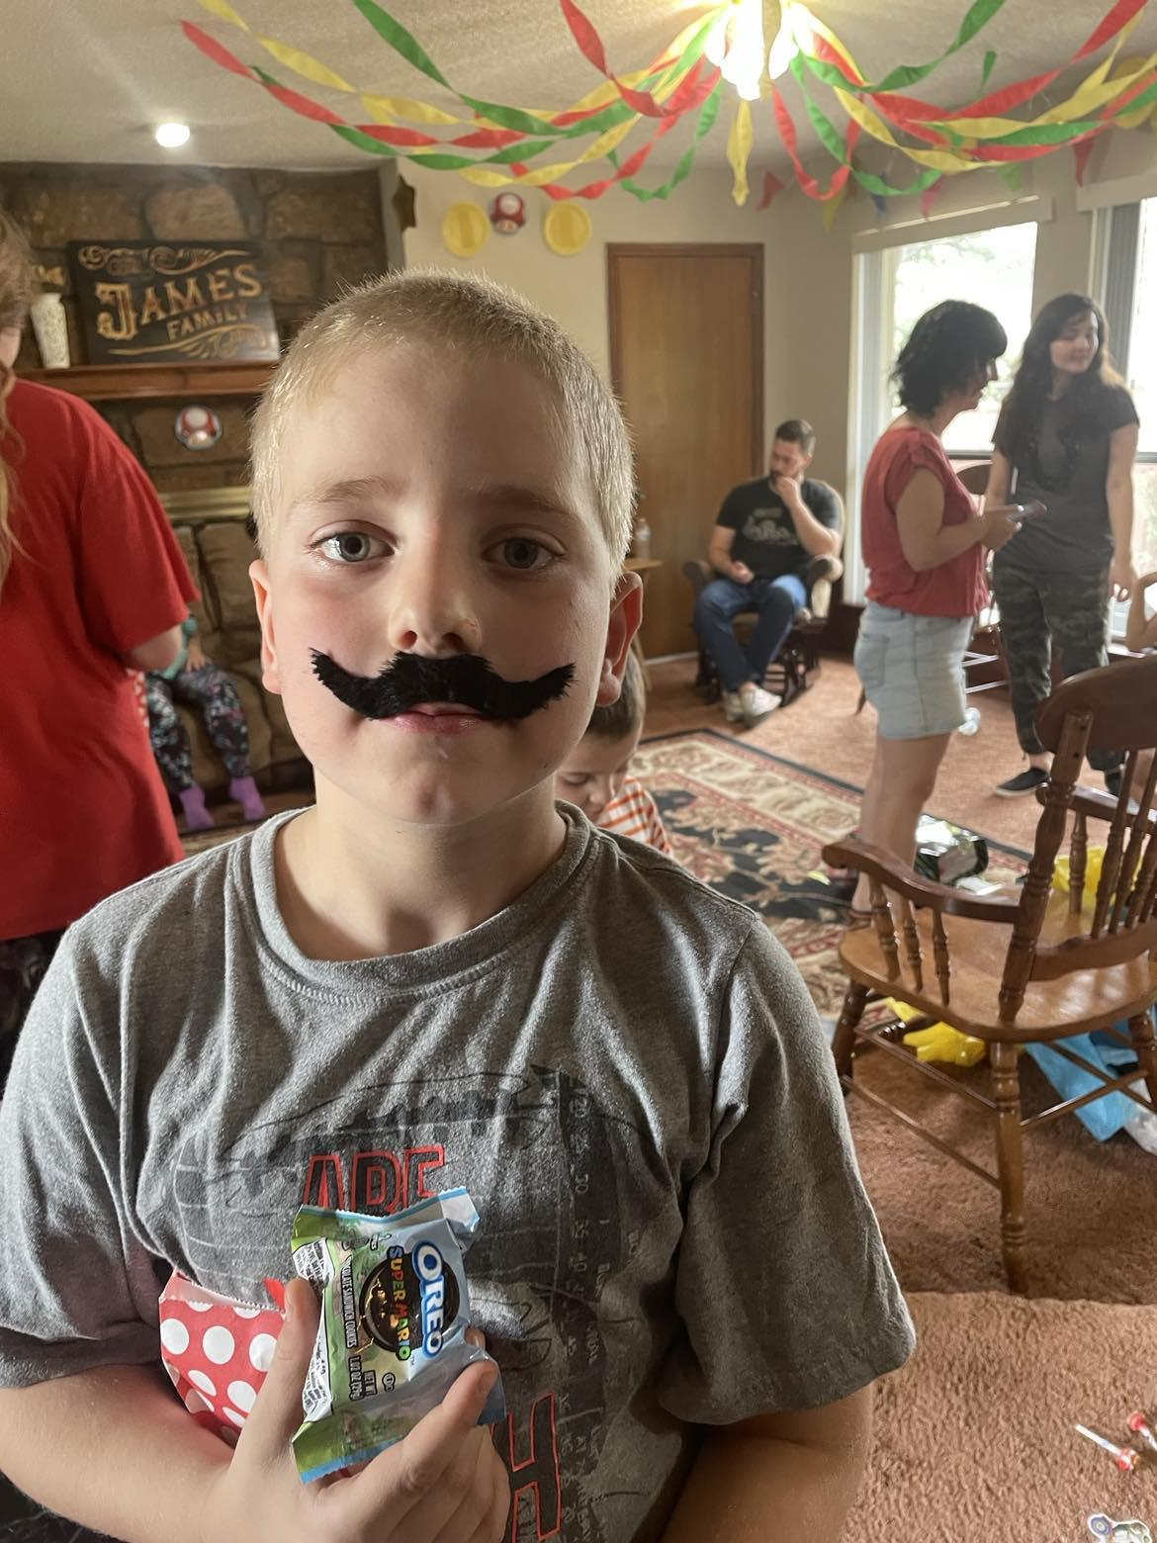
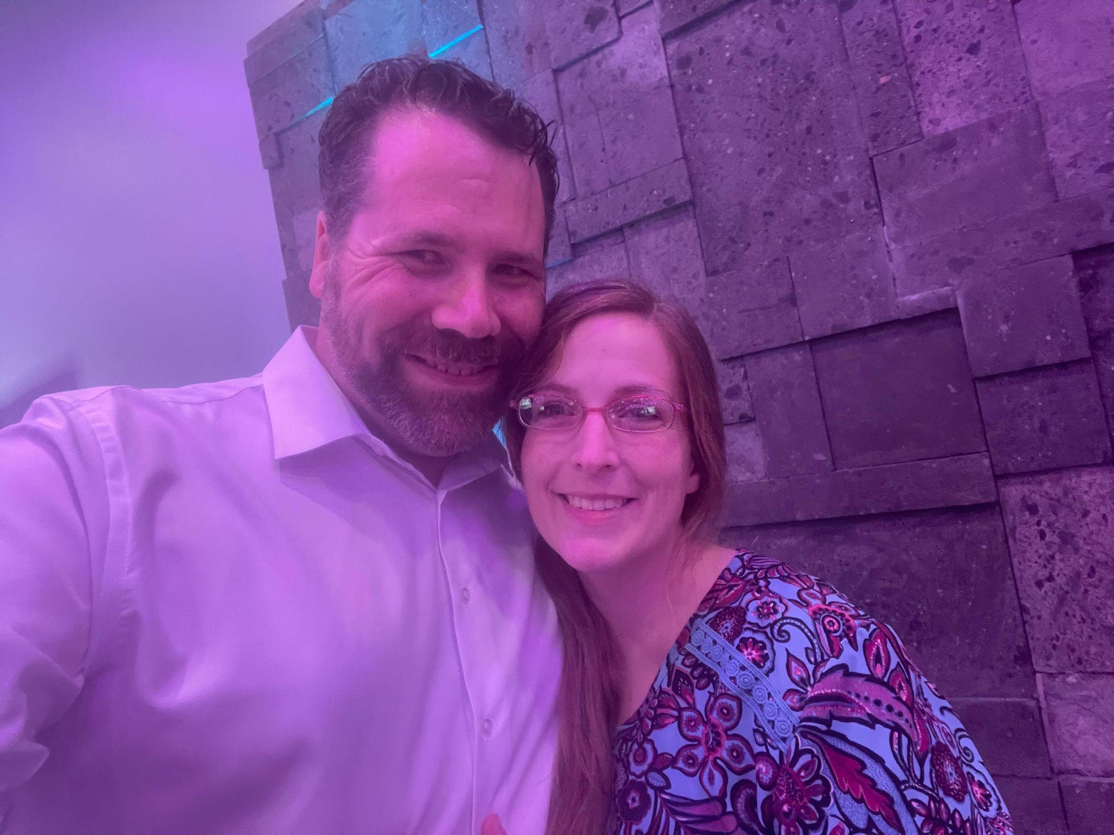
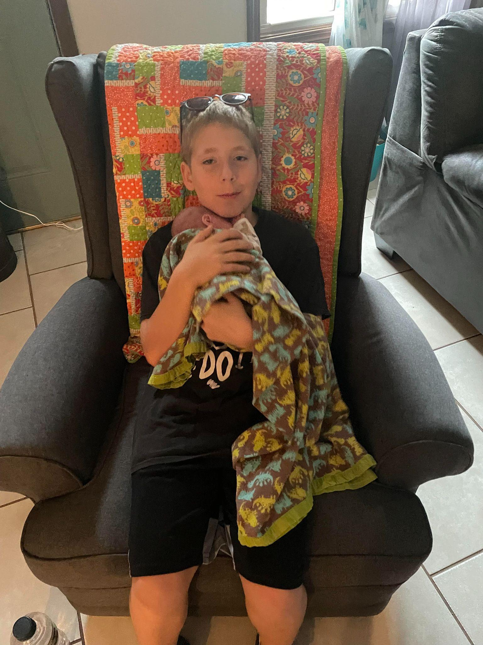

Slide 8
The Types of Work
Have a JOB
Own a JOB
Part-time preneur
Entrepreneur
Hardest JOB - Stay at home mom
2nd Hardest JOB being married to an Entrepreneur

Slide 10
The 5 Go-Giver Laws
The Law of Value. Your real worth is defined by how much more value you give than how much you get paid. ...
The Law of Compensation. Your income is decided by the number of people you serve and how well you serve them. ...
The Law of Influence. ...
The Law of Authenticity. ...
The Law of Receptivity.

Slide 11
The Law of Value. Your real worth is defined by how much more value you give than how much you get paid
Provide so much value that people think you are fake.
Provide so much value that people never question your value.
Create Power of Moments

Slide 12
The Law of Compensation. Your income is decided by the number of people you serve and how well you serve them.
How are you serving people? To serve others not yourself
Can you think of some ways to serve others?
When the deal is a good deal don’t try to renegotiate
Story - Steven
Bad deal, Provide work, treat to coffee, most importantly fellowship and giving without expectations of return.

Slide 13
The Law of Influence. ...
Networking
Provide value to others to become a man or woman of interest.
Secretes
Working a room
Being in a room networking

Slide 14
The Law of Authenticity. ...
Be yourself…..
“You are the Son or Daughter of a King that loves you and he has made you to be exactly who you are.”
“Do not fear. I have redeemed you. I have summoned you. You are mine” (Isaiah 43:1)

Slide 15
The Law of Receptivity.
Be open to others helping you back
When someone offers to help its okay to be uncomfortable
Don’t Steal someone else's blessing by not accepting

